Slide 1
Current Status of the Geometry Database for the CBM Experiment
Akishina E.P.¹, Alexandrov E.I.¹, Alexandrov I.N.¹,
Filozova I.A.^{1,4}, Friese V.², Ivanov V.V. ^{1,3}
¹LIT, JINR, Dubna
²GSI, Darmstadt
³MEPhi, Moscow
⁴Dubna State University
NEC’2017, 25-29 September 2017
Montenegro, Budva, Becici
Joint Institute for Nuclear Research

Slide 2
The Causes of Low Efficiency of the Geometry Files management in the current approach
Operational Complexity (low adaptability);
Tendency to the errors (absence of approval procedure and rules of naming of versions).
Thus, the distribution of the geometry modules through a database appears a desirable solution.
NEC’2017, 25-29 September 2017
Montenegro, Budva, Becici

Slide 3
Geometry Database. Initial User Requests
• Store and retrieve the geometry of the CBM modules in TGeo format (binary);
• No need to be more granular (within module geometry) – typical size of ROOT ﬁle is small (several 10 kB);
• Two­‐dimensional versioning (time, context);
• Manage setups (combinations of module geometries);
• Direct interface to CBMRoot for geometry building;
• High availability, good performance for online access (during CBMRoot run);
• Possibility to create a full TGeo ﬁle for a given setup;
(for oﬄine use). Can be also realized within CBMRoot.
• Modular access patterns (read/write) on group/user levels – Interface to Collaboration Database
NEC’2017, 25-29 September 2017
Montenegro, Budva, Becici

Slide 4
Geometry DB. User Requirements
Basis for Geometry DB development:
User Requirements Document
of Geometry DB for the CBM experiment
http://lt-jds.jinr.ru/record/69336?ln=en
NEC’2017, 25-29 September 2017
Montenegro, Budva, Becici

Slide 5
Basic Definitions
Geometry Module
File in ROOT format with content of detector geometry
Setup Module
Geometry module, link to the mother geometry module, its placement in the mother module (transformation matrix or object of class TGeoMatrix)
Setup
Combination of setup modules which represents the full CBM geometry
NEC’2017, 25-29 September 2017
Montenegro, Budva, Becici

Slide 6
CBM Geometry Database
Geometry Database is the informational system to:
Store the modules of CBM;
Load the geometry modules for setup construction;
Construct setup from the stored modules;
Download;
Support different versions of setup.
NEC’2017, 25-29 September 2017
Montenegro, Budva, Becici

Slide 7
Expected Benefits
for CBM employees:
Usability;
Coding Minimizing.
for CBM top management:
Business transparency;
Base for monitoring.
NEC’2017, 25-29 September 2017
Montenegro, Budva, Becici

Slide 8
Setup Structure
NEC’2017, 25-29 September 2017
Montenegro, Budva, Becici

Slide 9
Users
Lead Developer
coordinator and responsible person for the entire CBM geometry
Developer
the responsible developer for one of modules
CBM user
CBM user can only read data. CBM user can be a human using GUI or an application using API
NEC’2017, 25-29 September 2017
Montenegro, Budva, Becici

Slide 10
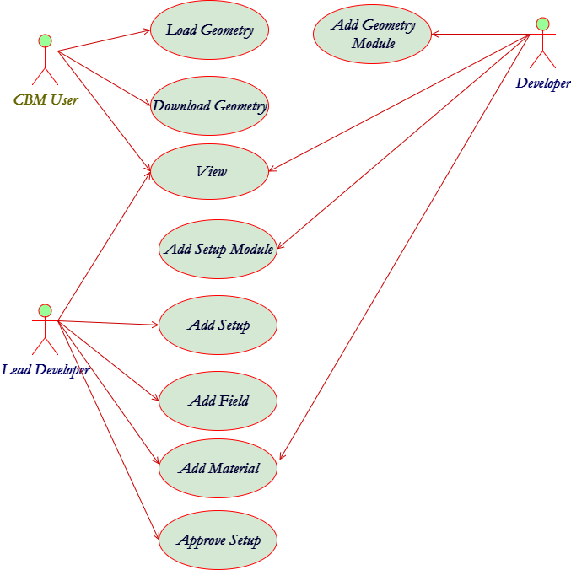
Geometry Database. Use Cases
The Geometry DB is used:
to provide interfaces to view, retrieve and update modules and setups
to store setups as combination of setup modules, magnetic fields and materials
to store setup modules as ROOT files and Transformation matrix
NEC’2017, 25-29 September 2017
Montenegro, Budva, Becici

Slide 11
Current Status of Development
Function
Load Geometry
Download Geometry
Web View
Add/Edit/Delete Geometry Module
Add/Edit/Delete Setup Module
Add/Edit/Delete Setup
Approve Setup
Add/Edit/Delete Field
Add/Edit/Delete Material
Authorization
Implemented
Partially Implemented
NEC’2017, 25-29 September 2017
Montenegro, Budva, Becici

Slide 12
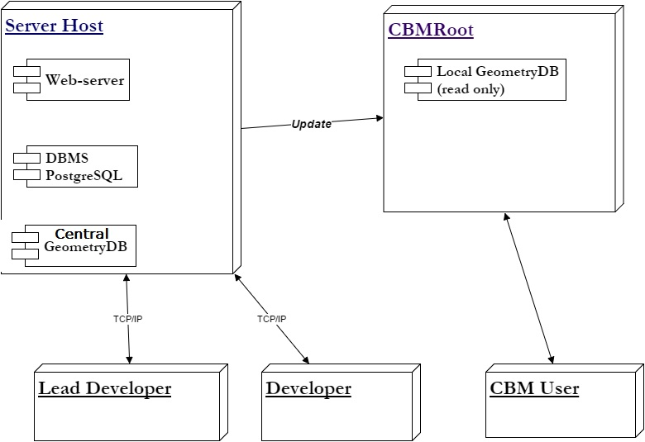
Component Diagram
Script for automatic data
convert
NEC’2017, 25-29 September 2017
Montenegro, Budva, Becici

Slide 13
The implementation of GUI and API
All types of Users can view the information from Geometry Database.
Lead Developer and Developer use Database to update data files corresponding to any object of Geometry DB. They can use:
GUI (Graphical User Interface) implemented as Web-interface.
API (Application Programming Interface) implemented as macros of the ROOT environment. Any macro can be used as executable file or can be called from other ROOT macros.
NEC’2017, 25-29 September 2017
Montenegro, Budva, Becici

Slide 14
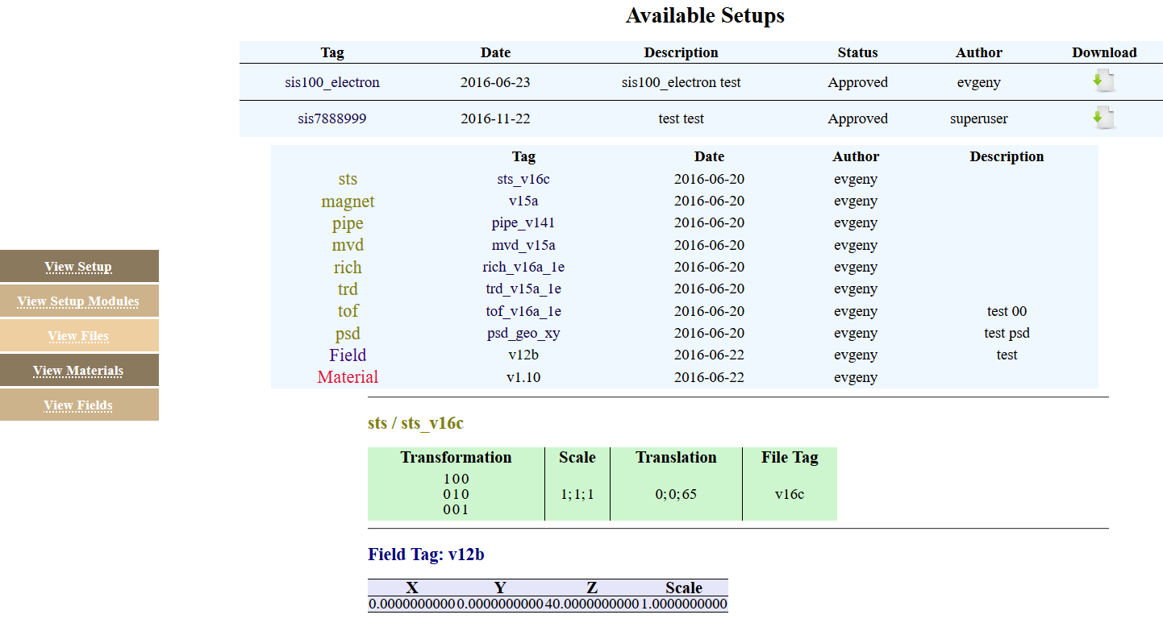
Web-interface. View Mode
NEC’2017, 25-29 September 2017
Montenegro, Budva, Becici

Slide 15
Web-interface. Configure Access

Slide 16
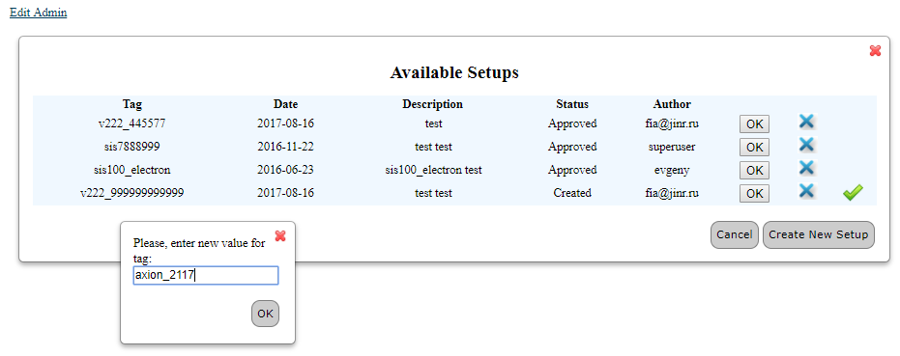
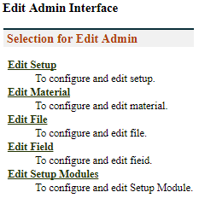
Web-interface. Edit Mode
To the Form for Setup Compiling
√
NEC’2017, 25-29 September 2017
Montenegro, Budva, Becici

Slide 17
Web-interface. Setup Compiling
NEC’2017, 25-29 September 2017
Montenegro, Budva, Becici

Slide 18
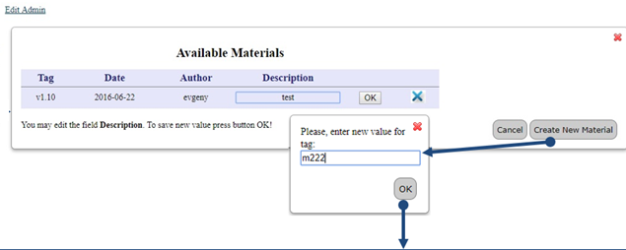
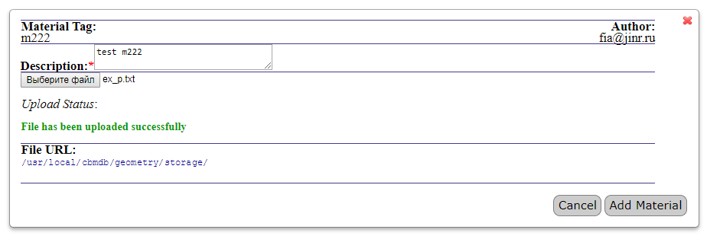
Web-interface. Add/Edit Material
√
NEC’2017, 25-29 September 2017
Montenegro, Budva, Becici

Slide 19
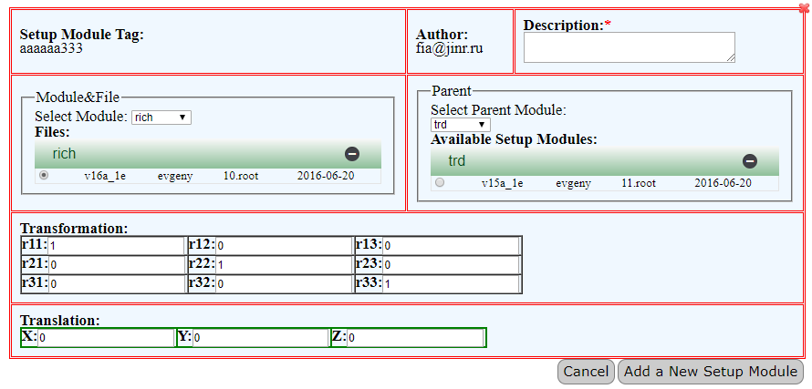
Web-interface. Add/Edit Setup Module
√

Slide 20
Macros
Macros are used by CBM users to obtain information about existing Setups and to load the needed Setup from Local Geometry DB into the memory of applications.
Requited following variable:
DBL_ROOT_PATH – path to data storage
DBL_FILE_NAME – name of sqllite file
TMP_PATH – path to temp directory
ERROR_MAT_PATH – path for convert relative path of material file to full path (will remove in future)
NEC’2017. 25-29 September 2017
Montenegro, Budva, Becici

Slide 21
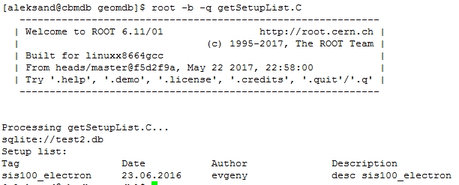
Get List Macros
getSetupList()
NEC’2017. 25-29 September 2017
Montenegro, Budva, Becici

Slide 22
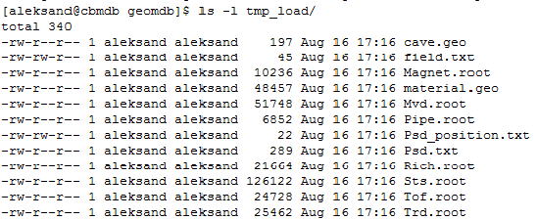
Download Macro
void downloadSetup(const char* tag, int subSetup);
Tag – tag of setup
subSetup – id of module of setup module
0 cave 1 magnet 2 pipe 4 mvd
8 sts 16 rich 32 trd 64 tof
128 psd 256 platform

Slide 23
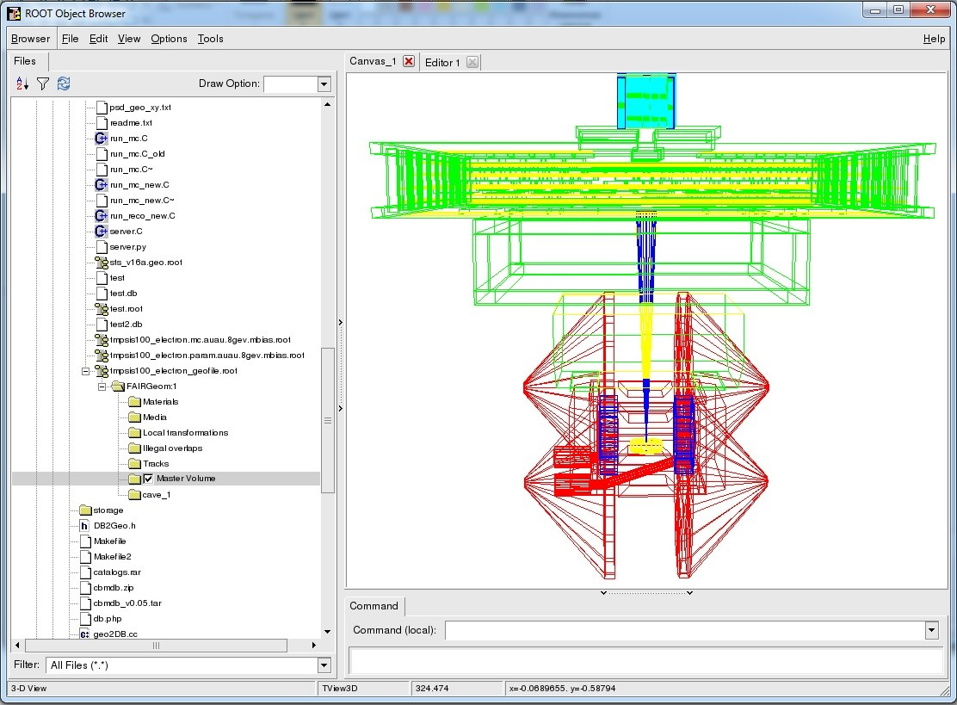
Load Setup Macro
gROOT->LoadMacro(“loadSetup.C”);
TString fun = "loadSetup(\"sis100_electron\")";
gROOT->ProcessLine(fun.Data());

Slide 24
Conclusion and Next Steps
Geometry DB prototype for storing and retrieving the geometry of CBM modules has been developed:
DB (PostgreSQL DBMS);
GUI (Graphical User Interface) tools;
API (Application Programming Interface) tools as a set of ROOT macros (Upload and Download)
Developer Authorization
Waiting of Feedback
Thanks for your attention!

