Slide 1
Security Issues Formalization
prof. Vladimir Dimitrov
Faculty of Mathematics and Informatics
University of Sofia, Bulgaria

Slide 2
Weakness (Common Weakness Enumeration - CWE)
A type of mistake in software that, in proper conditions, could contribute to the introduction of vulnerabilities within that soft-ware. This term applies to mistakes regardless of whether they occur in implementation, design, or other phases of the SDLC.

Slide 3
Vulnerability (Common Vulnerabilities and Exposures - CVE)
An occurrence of a weakness (or multiple weaknesses) within software, in which the weakness can be used by a party to cause the software to modify or access unintended data, interrupt proper execution, or perform incorrect actions that were not specifically granted to the party who uses the weakness.

Slide 4
Attack (Common Attack Pattern Enumeration and Classification - CAPEC)
A well-defined set of actions that, if successful, would result in either damage to an asset, or undesirable operation.

Slide 5
CWE, CVE & CAPEC
An attacker has to find and exploit a weakness, exposed by a weakness, and realize the vulnerability.
These are important concepts that are related but different. A weakness is a static presence existing in software systems -- it might stay in software and never cause any problems until it is exploited by an attacker, and when the attacker finds out the weakness (es) and exploit it (them), the vulnerability of this software is exposed.

Slide 6
Problems
What formal methods can be used to help formalize CWEs with required accuracy and precision and at the same time allow for further extensions?
To what granularity should CWEs be formalized? Finer granularity means more flexibility (especially when new weaknesses are identified, the extracted commonalities can reduce the re-invent work) but more effort to create them; coarser granularity indicates the easy-to-use weakness items while we need to re-invent the wheel every time.
How can the formalized CWEs be used and in which domains? For education and training? To prevent vulnerabilities? To integrate into software IDEs, test tools, and tools that generate test tools?
How can an automatic system be constructed to record newly identified vulnerabilities and classify them by CWEs? With better formalization and finer granularity of CWE definitions (which also means limited dictionary for weaknesses, better taxonomy of vulnerabilities), text mining could be the potential technique to mapping CVEs to CWEs at least semi-automatically.

Slide 7
CWE-119: Improper Restriction of Operations within the Bounds of a Memory Buffer
Description Summary
The software performs operations on a memory buffer, but it can read from or write to a memory location that is outside of the intended boundary of the buffer.
Extended Description
Certain languages allow direct addressing of memory locations and do not automatically ensure that these locations are valid for the memory buffer that is being referenced. This can cause read or write operations to be performed on memory locations that may be associated with other variables, data structures, or internal program data.
As a result, an attacker may be able to execute arbitrary code, alter the intended control flow, read sensitive information, or cause the system to crash.

Slide 8
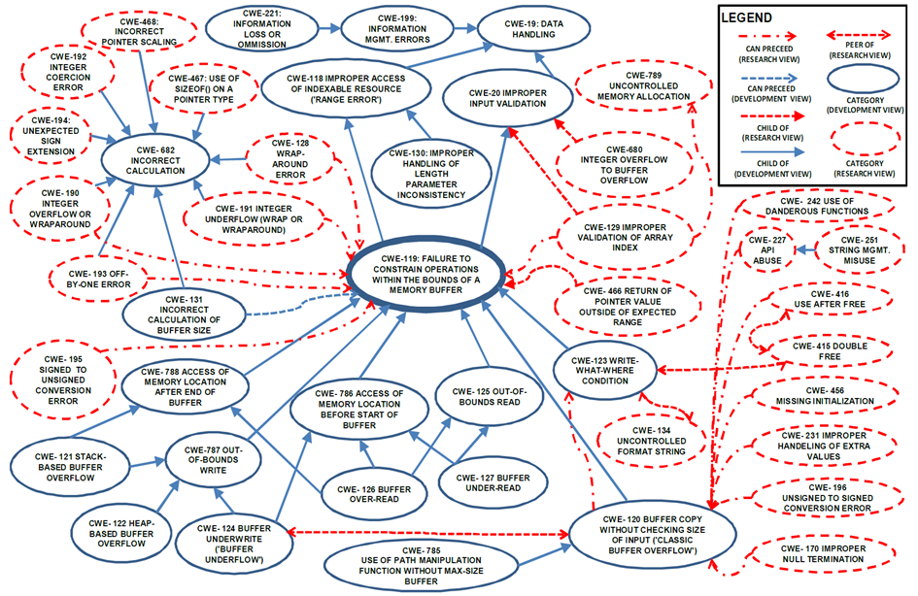
Semantic Template: Buffer Overflow-related CWEs

Slide 9
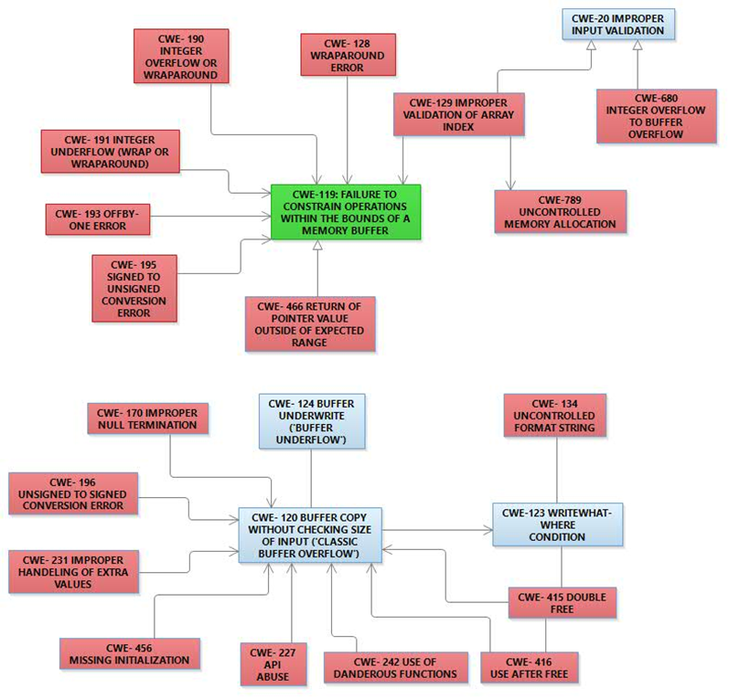
CWE-119 Research View

Slide 10
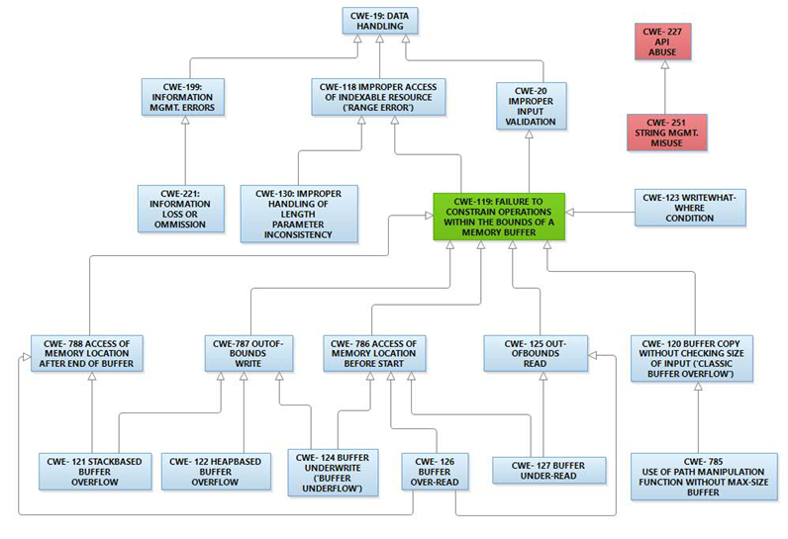
CWE-119 Development View with Inheritance

Slide 11
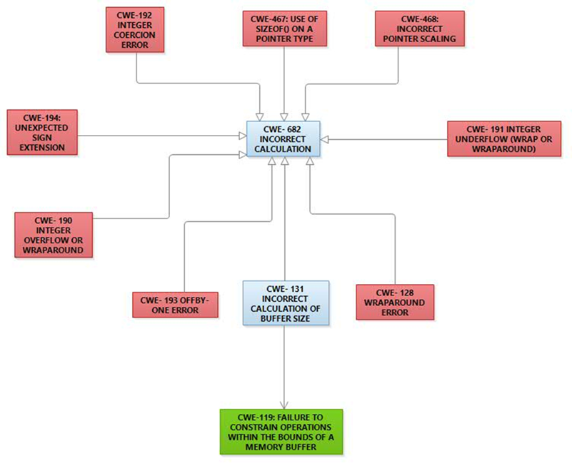
CWE-119 Development View with Precedence

Slide 12
CWE-119 Relationships

Slide 13
Conclusion
One big problem for representation of CWEs in UML diagrams is the need for automatization. The CWEs are represented in XML database, but some information is in text format. The purpose of Semantic templates is to extract formatted and unformatted information from the database.
CWEs representation in UML diagrams is good for better visual acceptance by humans. UML is well known notation in the community. There are many tools that support UML. Even more, specialized profiles for CWEs could be developed in UML.
It is convenient to generate code from UML in many tools. Such generators could be developed in the UML tools to generate test and verification sequences for CWEs.
UML is a notation for software specification. It is formalized with metaclasses by OMG. UML permits the software to be specified at the appropriate level of details in any case. If it is needed OCL can be used for further accuracy.
CWEs are organized in abstraction several levels. UML permits such a taxonomy organization with class and object diagrams. The class diagrams organize abstraction levels and the object diagrams stay on the base.
UML diagrams could be used for training, education and software development. Their notation is primary developed to humans. UML diagrams can be used as a source for generation of test sequences, verification code etc. that support the software development, testing and verification. Tools that support UML, like RSA, are usually open for that purpose.
Tools for semiautomatic identification of vulnerabilities and their classification to the CWEs could be implemented in object-oriented classification style using the artificial intelligence for text recognition and understanding. The work in that direction is huge and many research must be done but Semantic Templates are good starting point.

Slide 14
References
MITRE, http://www.mitre.org

