Slide 1
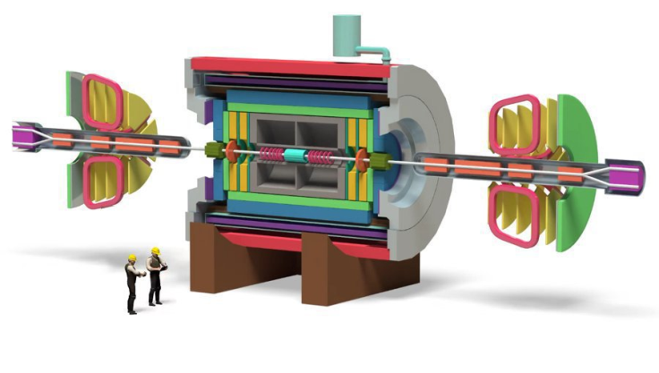
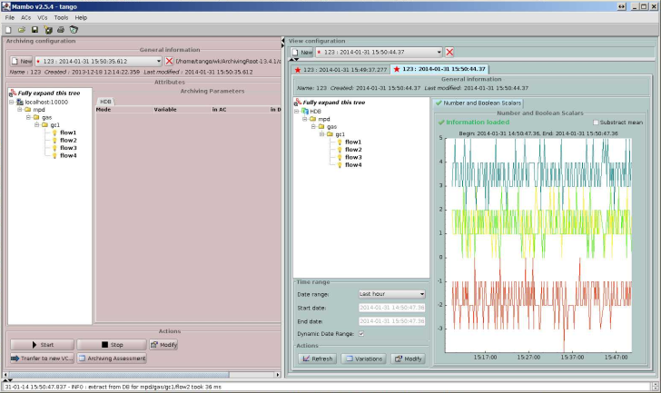
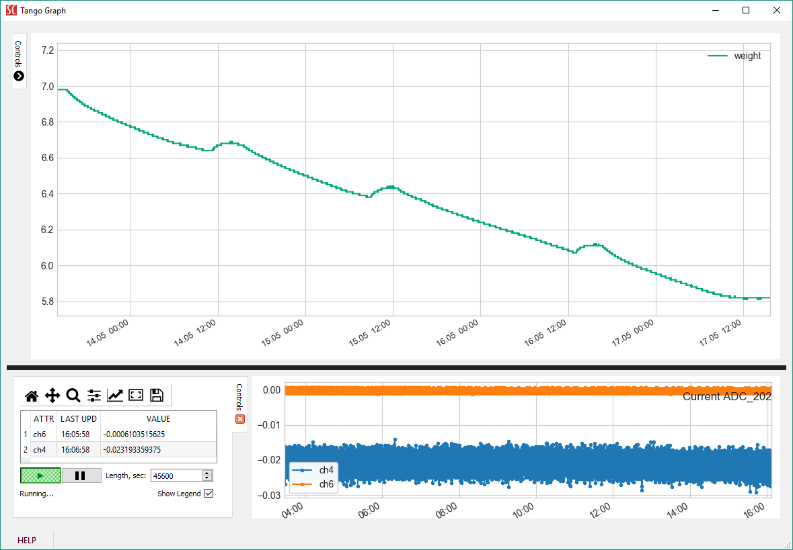
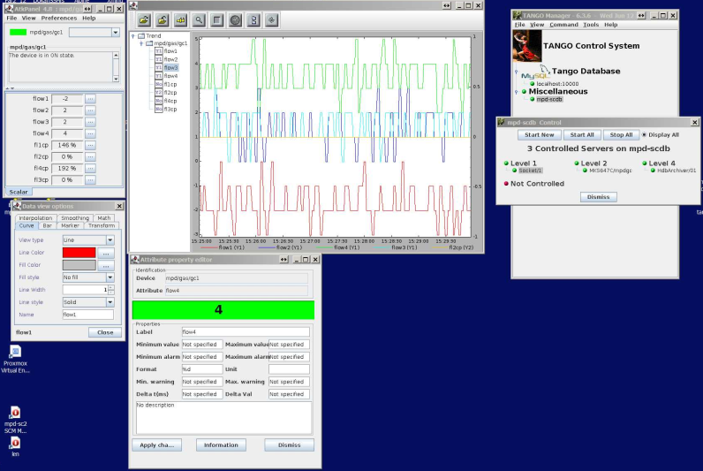
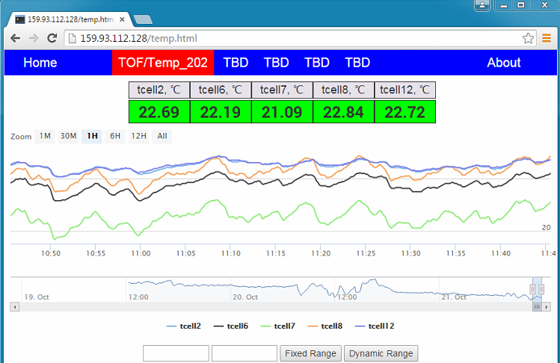
Multi-Purpose Detector (MPD) Slow Control System historical background, present status and plans
P.V. Chumakov, D.S. Egorov, R.V. Nagdasev, V.B. Shutov
NEC 2017 V.Shutov 1/22

Slide 2
Contents
1. Main tasks of the MPD Slow Control.
2. Peculiarities of the MPD Slow Control and system development goals.
3. Tango system as a backbone of the MPD Slow Control.
4. Infrastructure – computing, devices, interfaces …
5. Central services:
- SC data archiving, SC configuration database, access control, alarm system, logging …
6. Present status of the MPD Slow Control development.
7. Conclusions.
NEC 2017 V.Shutov 2/22

Slide 3
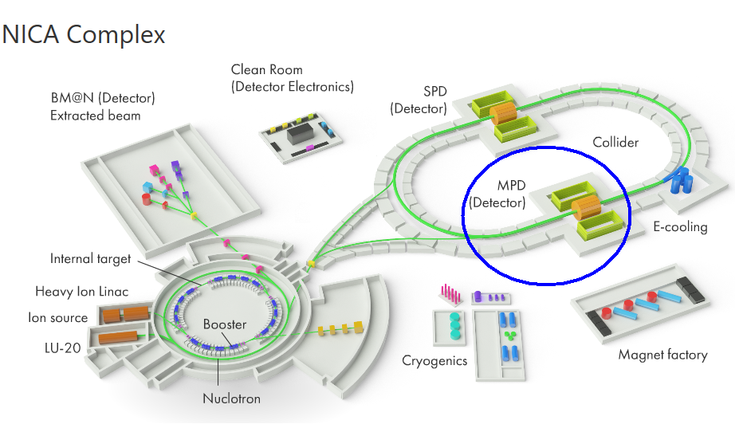
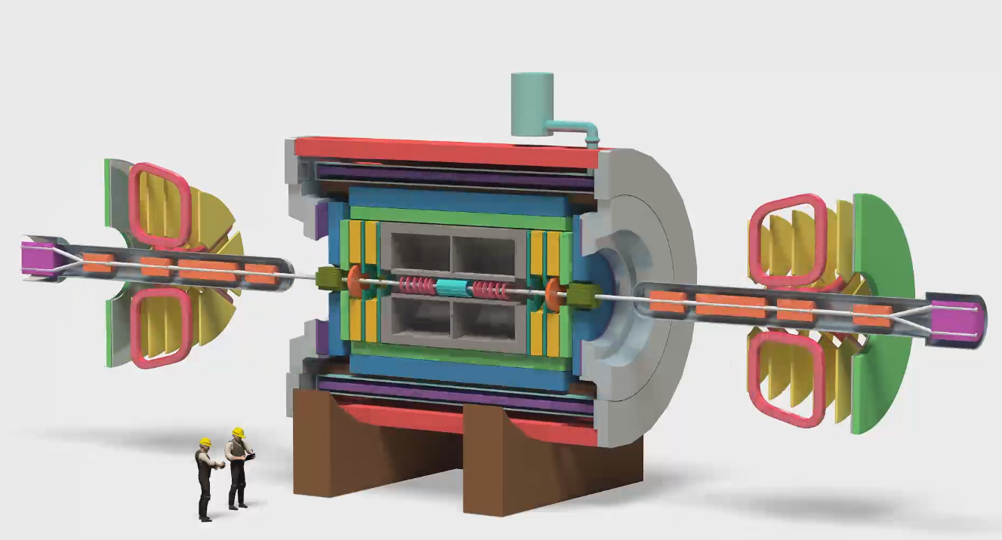
NEC 2017 V.Shutov 3/22

Slide 4
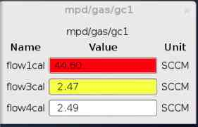
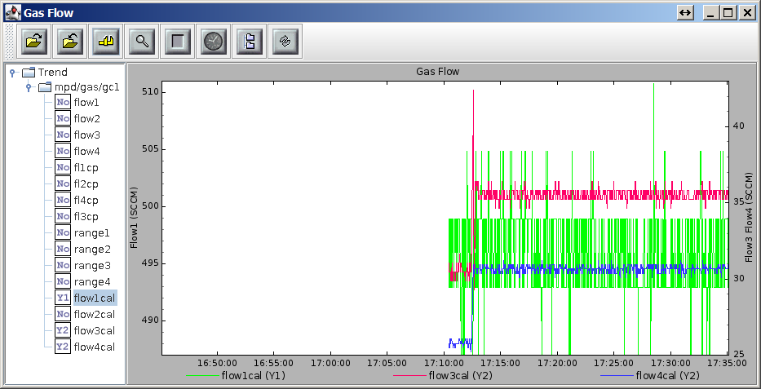
Main tasks of the MPD Slow Control
What is Slow Control, hardware and software-wise
1. Monitoring of the experimental hardware
2. [Centralized] control of the Slow Control equipment (LV, HV, gas flow etc.)
3. Archiving Slow Control data
4. Alarm system
5. SC Configuration database
…
Not a Slow Control:
Main data stream (data taking)
Event builder (reconstruction)/event display
Data quality
Run control
NEC 2017 V.Shutov 4/22

Slide 5
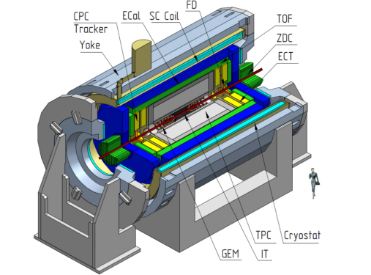
Peculiarities of the MPD Slow Control.
- extremely heterogeneous set of equipment to be monitored/controlled
- long historical background of Slow Control hardware and software in subdetectors groups
- weak “connections” between subdetectors SC equipment/software
- Slow Control typically being developed later than major parts of all other subdetectors -> requires easy scalability
FFD - Fast Forward Detector
TOF - Time of Flight system
TPC - Time Projection Chamber
Ecal - Electromagnetic CALorimeter
CPC tracker - Cathode Pad Chamber
DCH -Drift CHambers
ZDC - Zero degree Calorimeter tracker
NEC 2017 V.Shutov 5/22

Slide 6
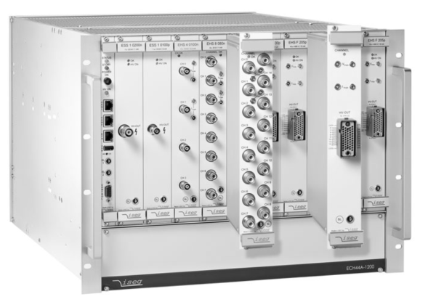
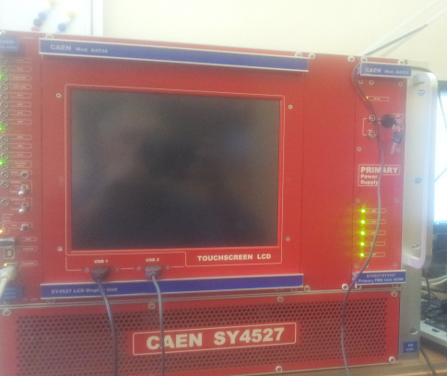
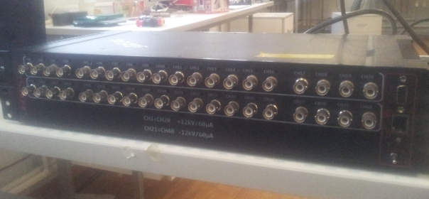
Example of diverse equipment used – HV power supplies
Several firms – Wiener / Iseg, Caen, HVSys, …
Hardware controlled by the software with ideologically different approaches:
Labview, OPC sever, standalone programs.
Protocols SNMP, OPC XML-DA, proprietary ones.
NEC 2017 V.Shutov 6/22

Slide 7
Main goals of the system development
[Centralized as much as possible and reasonable] control of diverse hardware
Reliability – monitoring of hardware and software operation
Easy incorporation of existing subsystems and new hardware
Storage of Slow Control data in unified format
Common Slow Control configuration database for all subdetectors (HV, thresholds etc. )
Access control
Scalability
Modern and easily customizable user interface
NEC 2017 V.Shutov 7/22

Slide 8
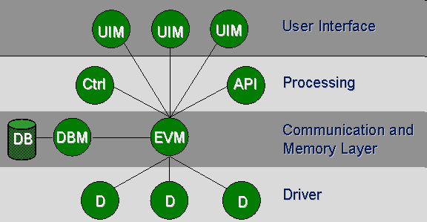
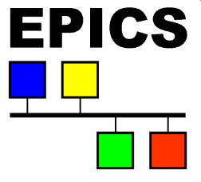
Tango vs EPICS vs commercial SCADA
- entry level complexity
- existence of wide active collaboration
- open source / price
- support price
…
Tango :
Already used LHEP accelerator complex
Open source
Competitive support price
JINR is a member of Tango Controls community.
PVSS
NEC 2017 V.Shutov 8/22

Slide 9
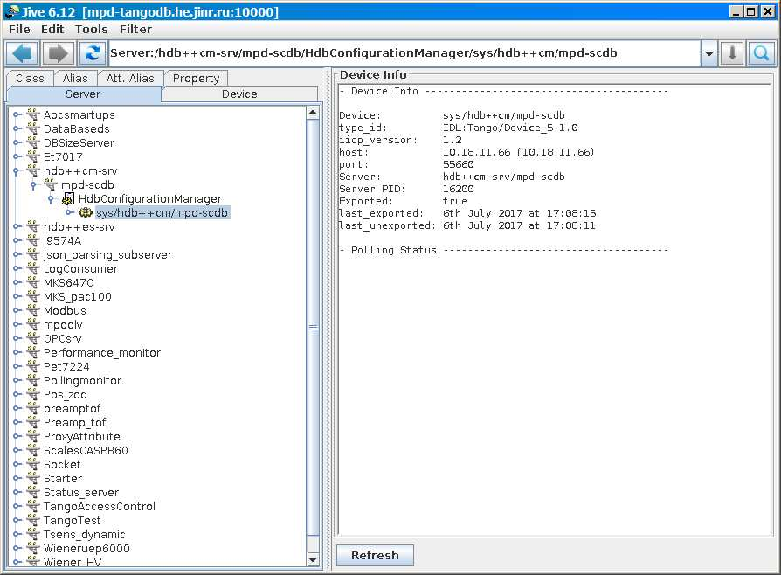
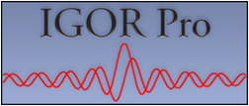
Tango Controls system as a backbone of the MPD Slow Control
TANGO control system is a free open source
device-oriented controls toolkit (middleware)
for building SCADA systems.
Multiplatform
Archiving service
Access control service
Logging service
Alarm service
Configuration tool
Administration tool
Web interface
Code generator for C++, Java, python
GUI Toolkit for Java, QT, Python
Commercial bindings (Labview, Matlab, IGOR Pro …)
NEC 2017 V.Shutov 9/22

Slide 10
MPD Slow Control System Layout
Client layer – Pcs (Linux, Windows)
PCs
Service layer -VMs (Linux)
Central Services:
- Tango DB
- Configuration DB
- Archiving
- ……
VMs
Applications
Device servers
storage
Tango middleware
Front-end layer
PCs
Ethernet – serial bus convertors(RS485, RS232 …)
devices
devices
devices
NEC 2017 V.Shutov 10/22

Slide 11
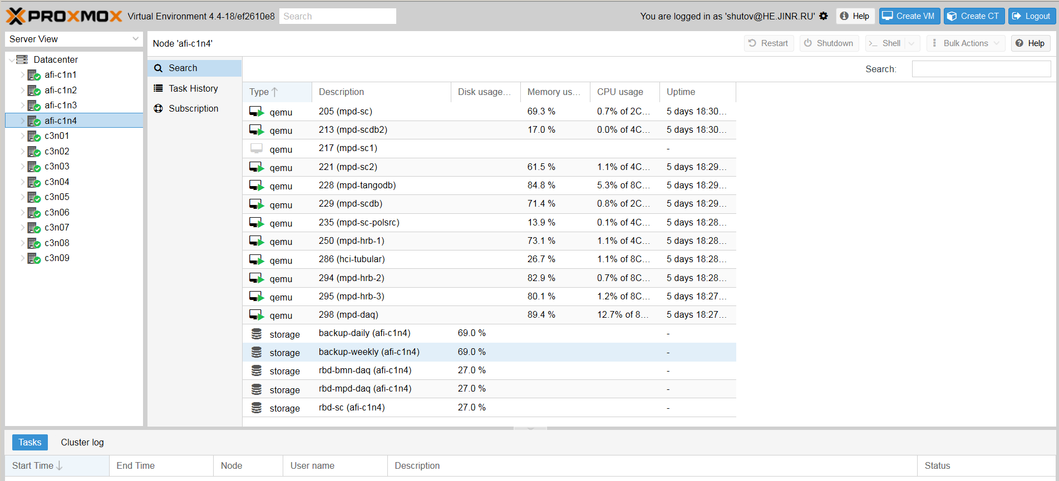
Infrastructure – computing, devices, interfaces …
At present time the service layer tasks uses existing MPD computing farm.
Virtualization is done using PROXMOX Virtual Environment.
All centralized services are running on dedicated VM’s
Front-end layer includes a wide variety of devices which are uses different buses and protocols, such as PXI, Ethernet, RS-485, RS232 etc.
NEC 2017 V.Shutov 11/22

Slide 12
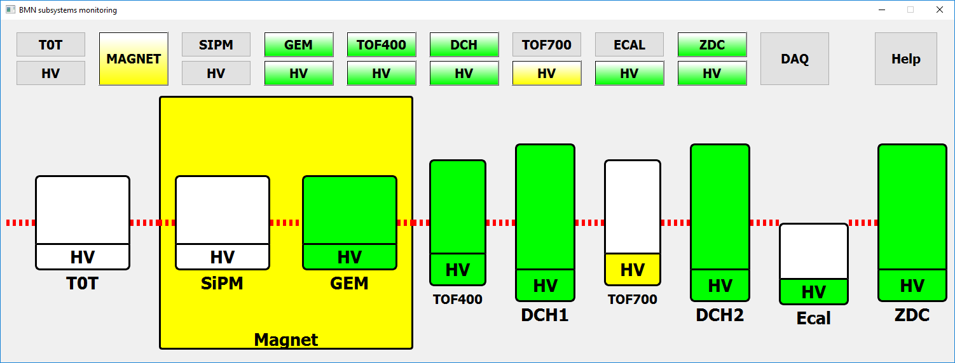
Main goals of the system development
[Centralized as much as possible and reasonable] control of diverse hardware
Reliability – monitoring of hardware and software operation
Easy incorporation of existing subsystems and new hardware
Storage of Slow Control data in unified format
Common Slow Control configuration database for all subdetectors (HV, thresholds etc. )
Access control
Scalability
Modern and easily customizable user interface
Subdetectors Slow Control subsystems are weak link of the whole system in terms of reliability. Monitoring of hardware and software on different levels is a strong necessity.
Status Server – a device server intended for collecting the current status information from all the applicable device servers of subdetectors. Event subscription system ensures no status value changes are missed. Accumulated data is processed forwarded to the client application.
NEC 2017 V.Shutov 12/22

Slide 13
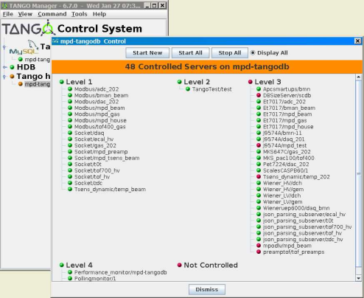
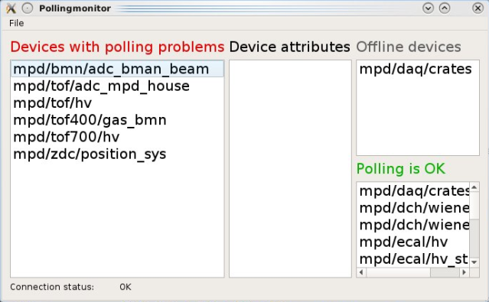
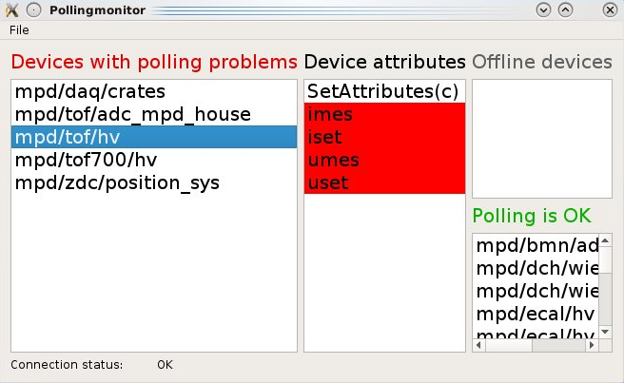
Main goals of the system development
[Centralized as much as possible and reasonable] control of diverse hardware
Reliability – monitoring of hardware and software operation
Easy incorporation of existing subsystems and new hardware
Storage of Slow Control data in unified format
Common Slow Control configuration database for all subdetectors (HV, thresholds etc. )
Access control
Scalability
Modern and easily customizable user interface
Monitoring of the software status
- system tools …
- polling Monitor – developed to permanently checks status of the device attributes being archived by TANGO Historical Database++
NEC 2017 V.Shutov 13/22

Slide 14
Main goals of the system development
[Centralized as much as possible and reasonable] control of diverse hardware
Reliability – monitoring of hardware and software operation
Easy incorporation of existing subsystems and new hardware
Storage of Slow Control data in unified format
Common Slow Control configuration database for all subdetectors (HV, thresholds etc. )
Access control
Scalability
Modern and easily customizable user interface
From the shelf tango proxy device servers
- socket, serial, modbus, TangoSnmp, OPCaccess, …
Unfortunately some of them are not applicable for existing equipment. Therefore we have to develop several proxy servers and clients to substantially simplify work with particular protocols or specific software. Among them
- JSON parsing server (JSON - JavaScript Object Notation data-interchange format)
- SNMP extended library (SNMP - Simple Network Management Protocol)
- OPC-tango server (OPC - OLE for Process Control)
– web parsing workaround for Siemens LOGO controllers
These are not the tools we used to develop software.
These are the tools we develop to develop software.
NEC 2017 V.Shutov 14/22

Slide 15
Main goals of the system development
[Centralized as much as possible and reasonable] control of diverse hardware
Reliability – monitoring of hardware and software operation
Easy incorporation of existing subsystems and new hardware
Storage of Slow Control data in unified format
Common Slow Control configuration database for all subdetectors (HV, thresholds etc. )
Access control
Scalability
Modern and easily customizable user interface
Incorporation of existing standalone software into system using JSON parsing server
JPS is a device server designed to handle JSON messages received from TCP socket and transform them into dynamic TANGO attributes.
Processes data from any valid JSON message, regardless of it’s structure;
Performs different commands at one socket at the same time;
Works with multiple types of data: numbers, arrays of numbers, strings.
Predeveloped standalone software
TCP socket proxy server
JSON parsing server
NEC 2017 V.Shutov 15/22

Slide 16
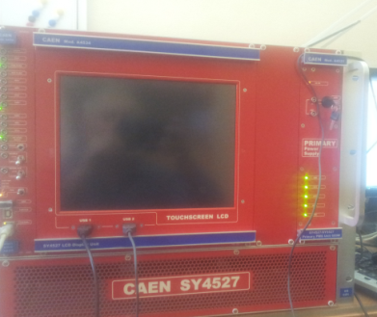
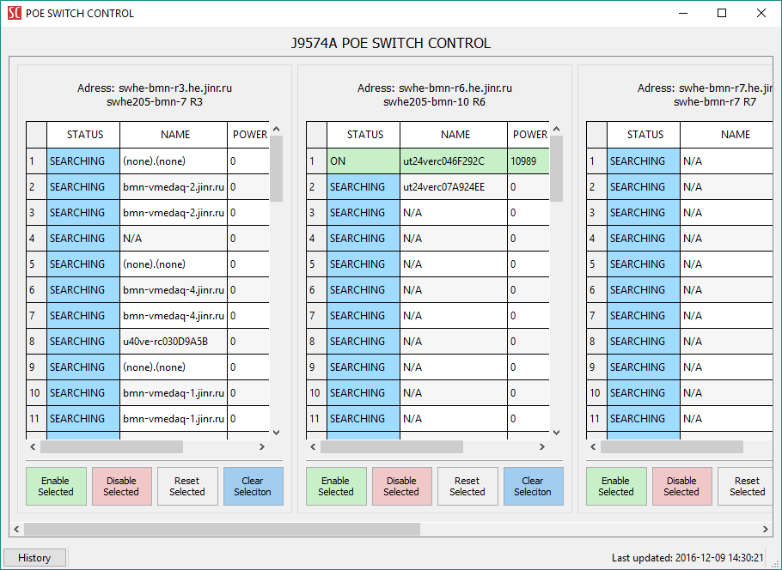
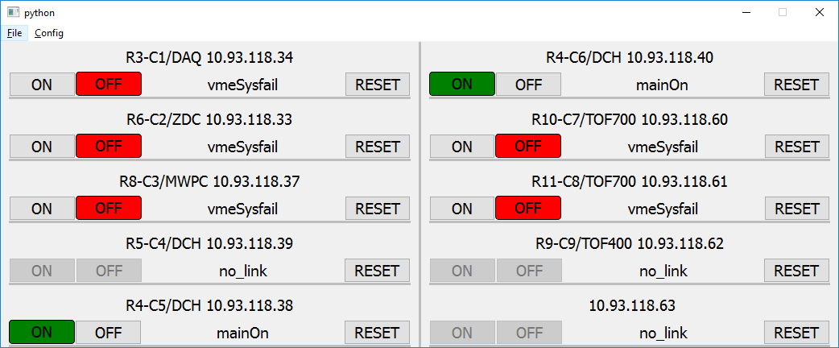
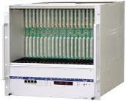
OPC-tango server (OPC - OLE for Process Control)
Easily configurable via tango server properties
Sends or requests data to/from OPC server according to configuration
Works with multiple types of data.
Examples of usage:
CAEN High Voltage crate monitoring/control
ZDC positioning system
SNMP extended library (SNMP - Simple Network Management Protocol)
Examples of usage:
POE network switch control client
Wiener crates control/monitoring
client.
NEC 2017 V.Shutov 16/22

Slide 17
Main goals of the system development
[Centralized as much as possible and reasonable] control of diverse hardware
Reliability – monitoring of hardware and software operation
Easy incorporation of existing subsystems and new hardware
Storage of Slow Control data in unified format
Common Slow Control configuration database for all subdetectors (HV, thresholds etc. )
Access control
Scalability
Modern and easily customizable user interface
Common Slow Control configuration database for all subdetectors
Needed to load running configuration of the Slow Control equipment
(High Voltage, thresholds etc. ) from single control center.
Status:
Common Slow Control configuration database - to be done, work is started.
Access control – work is in progress
NEC 2017 V.Shutov 17/22

Slide 18
Main goals of the system development
[Centralized as much as possible and reasonable] control of diverse hardware
Reliability – monitoring of hardware and software operation
Easy incorporation of existing subsystems and new hardware
Storage of Slow Control data in unified format
Common Slow Control configuration database for all subdetectors (HV, thresholds etc. )
Access control
Scalability
Modern and easily customizable user interface
Tango graph
Tango Graph is universal. flexible and intuitive replacement for existing plotting tools like atkmoni.
Tango Graph provides real-time monitoring of scalar attributes with many
useful options.
NEC 2017 V.Shutov 18/22

Slide 19
Tango graph
Can handle multiple graphs, independent from each other, with different timescales, polling period and many other options
Loadable attribute pre-history from database to display directly on graph
Completely configurable with a single .ini file
Space saving
Every section has it’s instruments for view manipulation, such as pan-view and zoom
Any point of data can be annotated and tracked
Provides section view export in common formats like PDF, SVG.
NEC 2017 V.Shutov 19/22

Slide 20
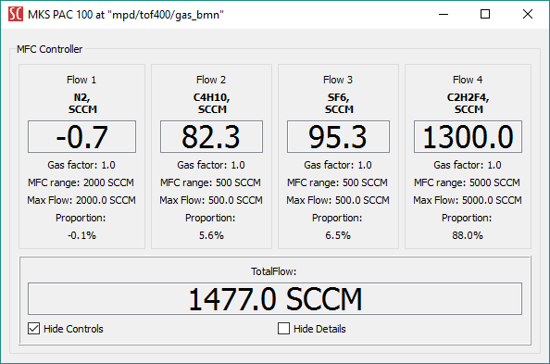
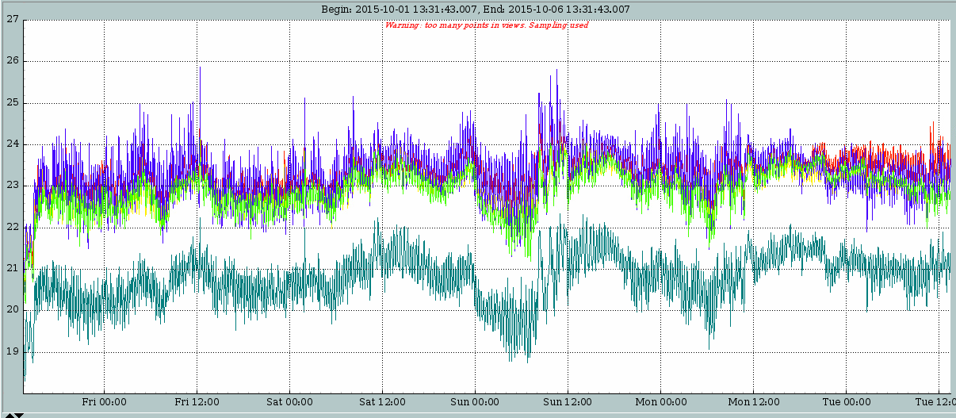
Some other tasks of MPD Slow Control
RPC chambers gas flow control
Temperature monitoring
High voltage control/monitoring
Low voltage power supply monitoring
Preamplifiers threshold control
Gas bottle weight monitoring
…
NEC 2017 V.Shutov 20/22

Slide 21
Conclusion
- Created base structure of Slow Control for MPD including databases, archiving system, alarms system, etc.
- Developed software for various hardware used in MPD subdetectors Slow Control.
- Essential part of MPD Slow Control system was testes during several BM@N runs at Nuclotron.
Obvious things to be done:
Common Slow Control configuration database for all subdetectors (HV, thresholds etc. )
Access control
Continue to extend MPD Slow Control system as equipment arrives and come to operation
Problems:
- manpower (mainly for devices programming)
- convincing subdetector groups to pay more attention to their Slow Control tasks in frame of the unified MPD Slow Control.
NEC 2017 V.Shutov 21/22

Slide 22
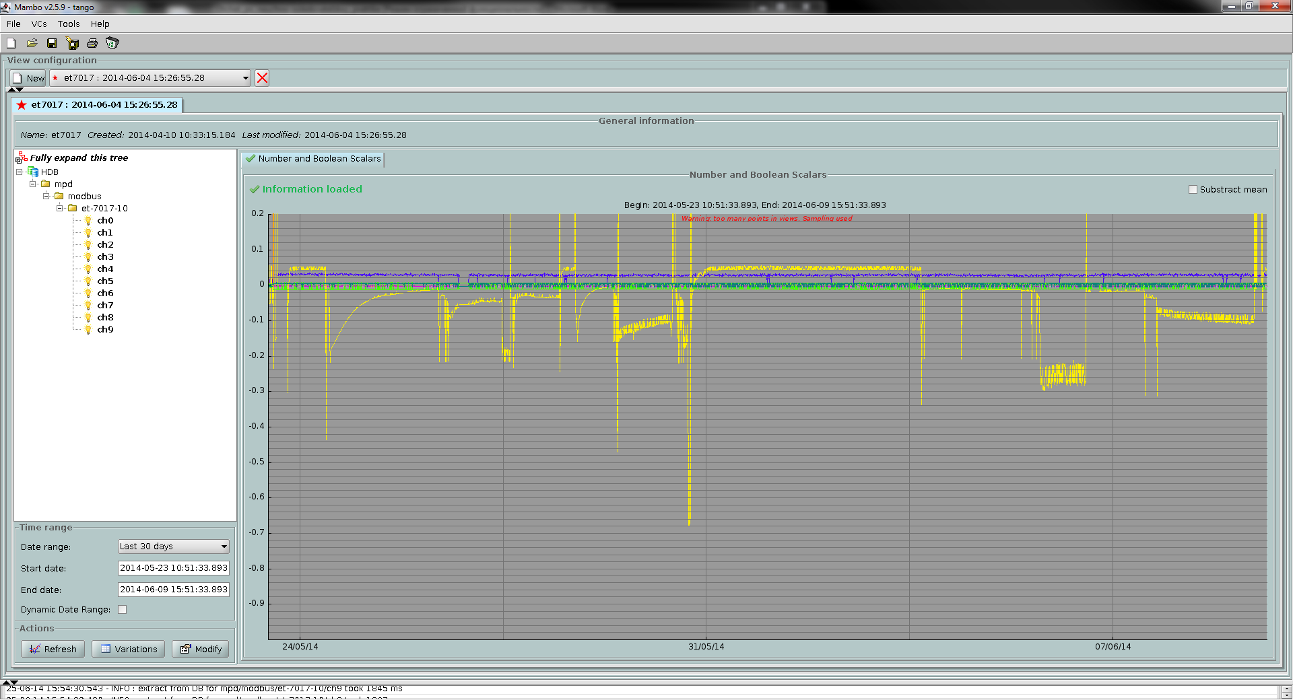
Thank you for your attention
NEC 2017 V.Shutov 22/22

