Slide 1
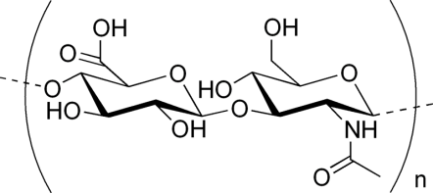
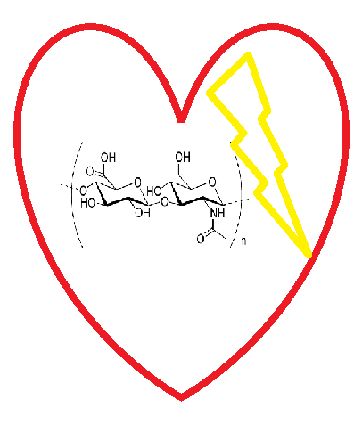
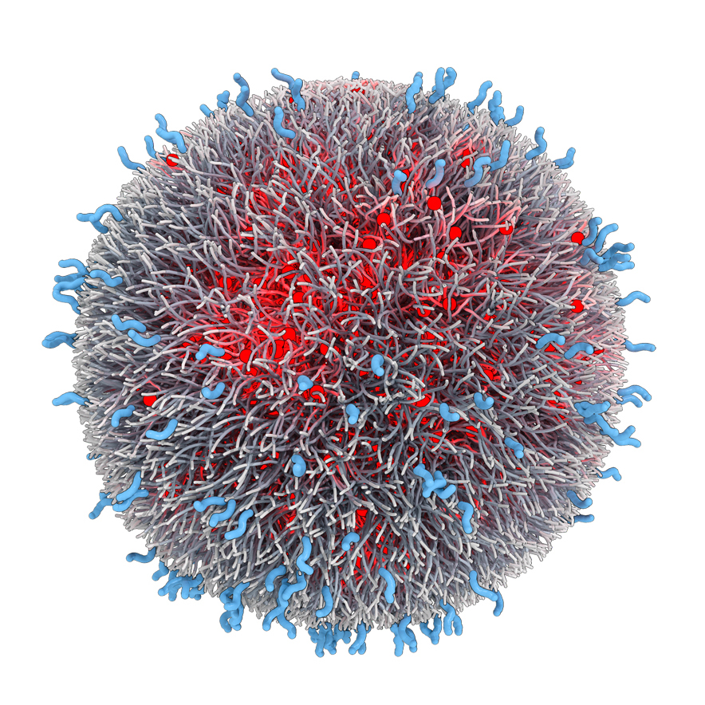
THE RADIOBIOLOGICAL NEWS
AYSS2018
JINR, Dubna
April 25
Editor's notes:
Breaking news:
HYALURONIC ACID new in town
Dear readers.
You are holding special edition of ours radiobiological news due to focusing on the topic ...
Showbiz news:
NEW LOVE
STORY
HA and IZ catch
together
Business news:
NANOPARTICLES
The best investment these days

Slide 2
Editor's note:
Special issue edition:
Can nanoparticles from hyaluronic acid protect against ionizing radiation?
Editor in chief no.1:
Zuzana Šinkorová
Editors:
Anna Lierová
Marcela Jeličová
Dept. Radiobiology,
Faculty of Military Health Sciences,
University of Defense in Brno,
Hradec Kralove, CR
Editor in chief no.2:
Zuzana Bilková
Editors:
Jitka Kašparová
Lucie Korecká
Dept. biological and biochemical sciences,
Faculty of chemical technologies,
University of Pardubice,
Pardubice, CR

Slide 3
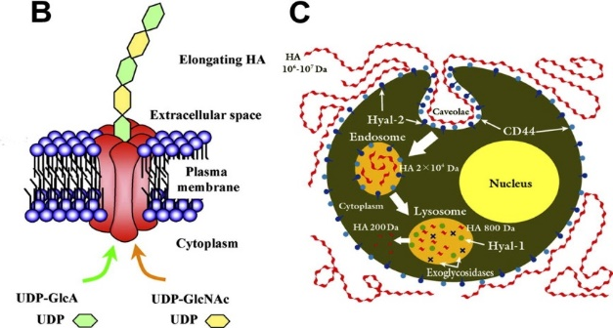
BREAKING NEWS
Hyaluronic acid (HA)
Glycosaminoglycan
Main components of ECM
One of the most hydrophilic molecule in nature
Primary function: tissue hydration and maintained homeostasis of environment
Own metabolite pathway with relative proteins
Structure of HA
Notes:
Hyaluronic acid was first isolated from the bovine vitreous body in 1934 by Dr. Karl Meyer,
Hyaluronic acid is a linear polysaccharide.

Slide 4
HA metabolic pathway
REVEAL the SECRET
Dicker at al., 2014, Acta Biomaterialia
Notes:
The next step came in 1970 with the introduction of a specific enzyme that could degrade hyaluronan to a defined product, which could be measured in the presence of other polysaccharides and other impurities. Second, our growing knowledge of hyaluronan receptors and their interactions with intracellular components will give us an insight into their functions and thereby the function of hyaluronan.

Slide 5
the
SECRET
„SIZE really matter“
Important determinant of its biological activity
High molecular weight HA
$$>1000 saracharides$$
Low molecular weight HA
$$<1000 saracharides$$
Inaate product
Anti-inflammatory, immuno-suppressive
Inhibit angiogenesis
Pivotal role in the maintenance of healthy connective tissue
20MDa: ovulation, embryogenenis
Produce during injury
inflammatory, immuno- stimulatory
Pro – angiogenic
Activation of intracellular cascade leading to cytokine production
DAMP (20-200kDa)

Slide 6
SHOWBIZ NEWS
Effect of ionizing radiation on HA
HA shows after irradiation a significant decrease of viscosity which is relative to the intensity of radiation.
Product of ROS degradation is LOW MOLECULAR WEIGHT HA.
…HOWEVER…
Notes:
IZ cleaveged moleculu to unwanted short string but of the hyaluronan synthases and hyaluronidases and their regulation will make it possible to up- and downregulate hyaluronan production in such biological systems

Slide 7
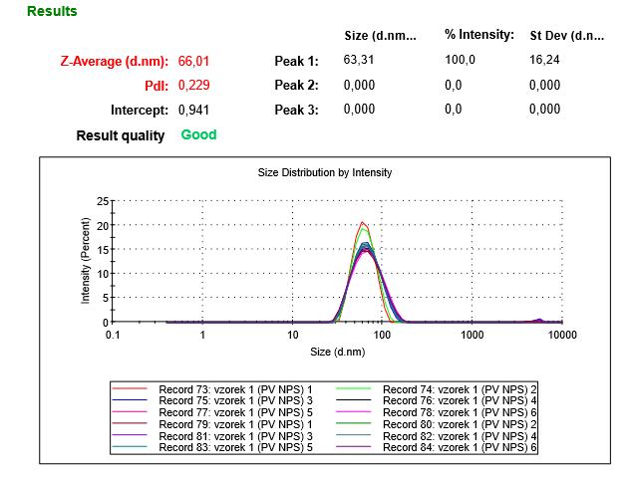
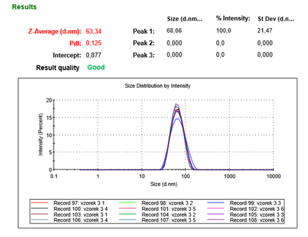
BUSINESS NEWS
NANOPARTICLES (NP) from hyaluronic acid
original molecule: HMW HA (1,5 - 1,8 MDa)
preserving the extraordinary properties
NP are NOT affected by ionizing radiation
Original sample
Sample after 10 Gy , 24h
Sample after 20 Gy, 24h
Notes:
Chemical structure allowed formation of nanoparticles
NP still keep their biological properties as biocompatibility, biodegratation and ability to interackt with protein partners
But, the degradiation by enzymes isn´t not effective what resolve in longer present in organizus
And the most important property of Nanoparticles is that they are not degradted by ROS. Thios hypotesis was confirmed in our experiments, when we irradaition NP in aqueous medium with doses of 10 and 20 Gy. The nanoprticles were re – measured 24h later and as u cen see on graphs the are any diversities from original sample.

Slide 8
The MOST important
HA alone has distinct biophysical, biomechanical properties and biological functions of HA
Interactions of HA / HABPs exhibits significant difference properties and events
HA NP allowed combination of both advanced HA properties and targeted NP technology

Slide 9
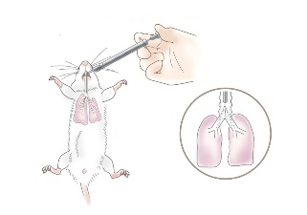
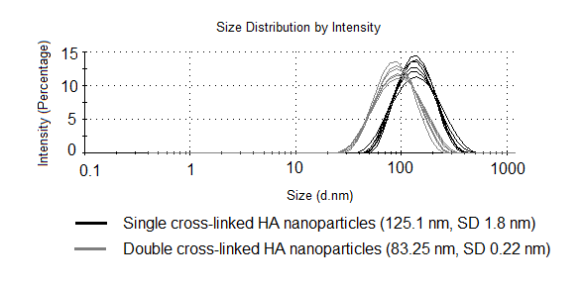
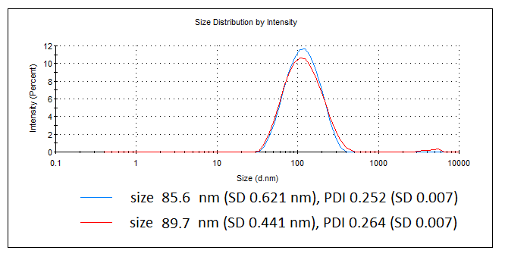
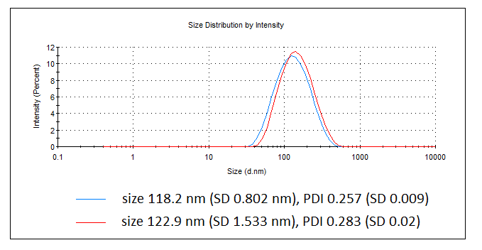
Next issue
Treatment with NP
Partial irradiation
17 Gy
Dissection at:
113
155
180 days after irradiation
Prepared NP
83,25 ± 0,22 nm
125,1 ± 1,8 nm
85,6 ± 0,252 nm
118,2 ± 0,802 nm

Slide 10
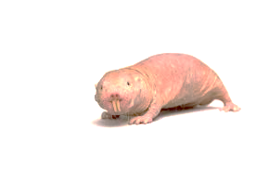
Editor's note:
Special issue edition:
Can nanoparticles from hyaluronic acid protect against ionizing radiation?
Editor in chief no.1:
Zuzana Šinkorová
Editors:
Anna Lierová
Marcela Jeličová
Dept. Radiobiology,
Faculty of Military Health Sciences,
University of Defense in Brno,
Hradec Kralove, CR
Editor in chief no.2:
Zuzana Bílková
Editors:
Jitka Kašparová
Lucie Korecká
Dept. biological and biochemical sciences,
Faculty of chemical technologies,
University of Pardubice,
Pardubice, CR

