Slide 1
A topology-based investigation of the Ti-doping effects on the K⁺ conductivity in doped K(Fe,Ti)O₂ solid electrolyte
Pavel Zolotarev, Roman Eremin
Samara Center for Theoretical Materials Science (SCTMS), Samara, Russia

Slide 2
Purposes of the study
Description of entries of the modeled configurational space of K(Fe,Ti)O₂ solid electrolyte by means of a set of structural descriptors
Elucidation of the Ti doping influence on the energetic characteristics of vacancy formation and K-ion migration

Slide 3
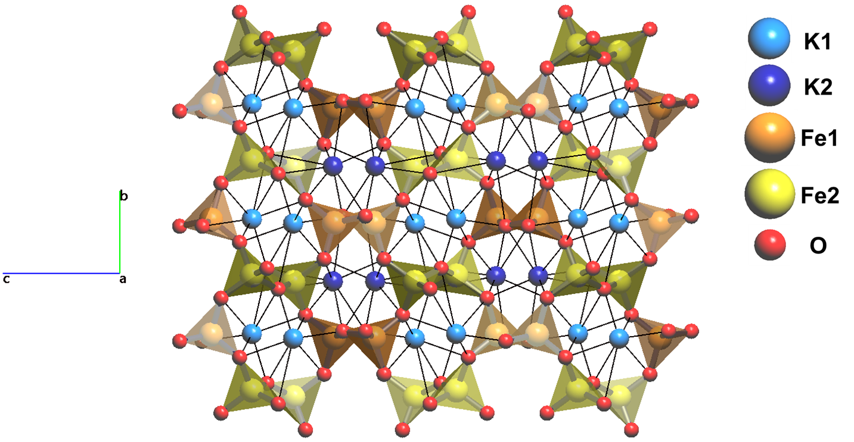
KFeO₂ crystal structure
low-temperature orthorhombic Pbca polymorph

Slide 4
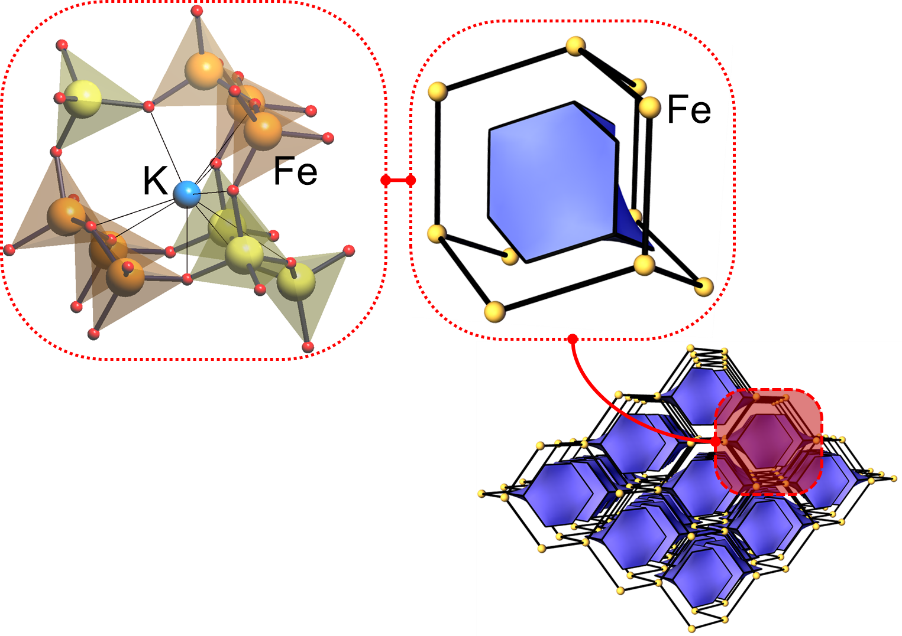
KFeO₂ crystal structure
cage

Slide 5
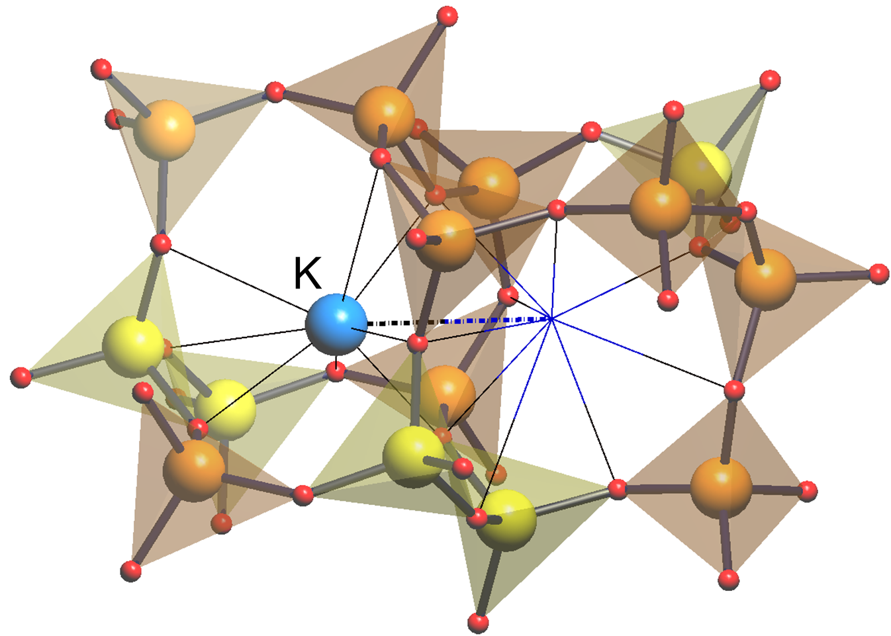
K ion vacancies and migration paths
pathway of the K ion to the neighbour cage

Slide 6
Improvement of the ion-conduction properties through doping - 1Ti configurational space
K₃₁Fe₃₁TiO₆₄ (modified 2x1x1 supercell of KFeO₂):
- 64 non-equivalent configurations with one K vacancy and
- 128 non-equivalent pathways of the K ion migration
….

Slide 7
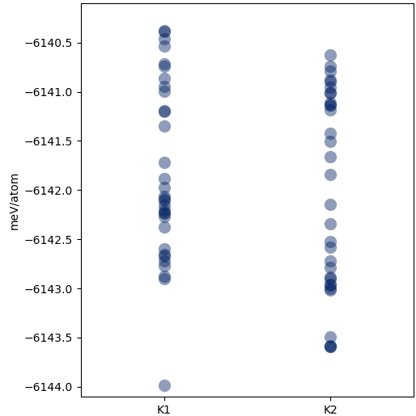
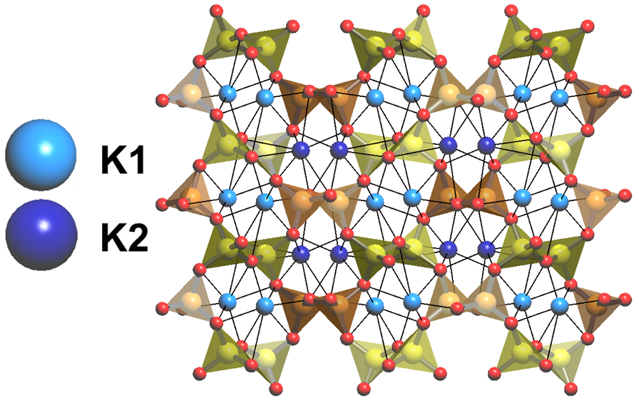
Descriptors of the K ion vacancies formation
vacancy positioning in K sublattice
vacancy in K1/K2 position

Slide 8
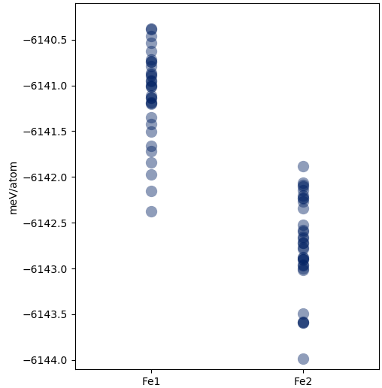
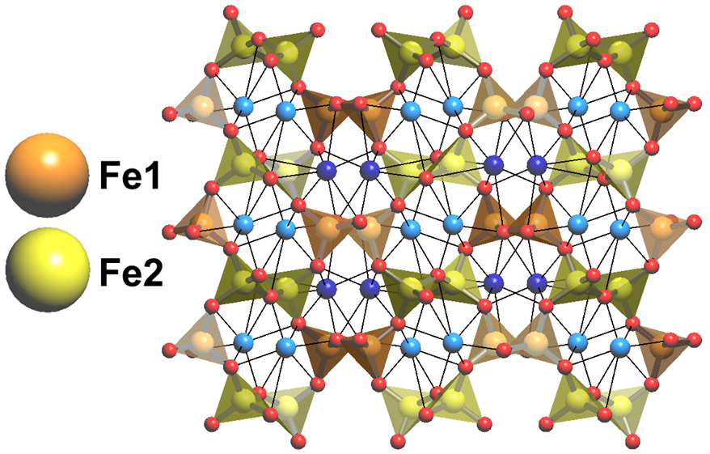
Descriptors of the K ion vacancies formation
Ti atoms positioning Fe sublattice
Ti atom in Fe1/Fe2 position

Slide 9
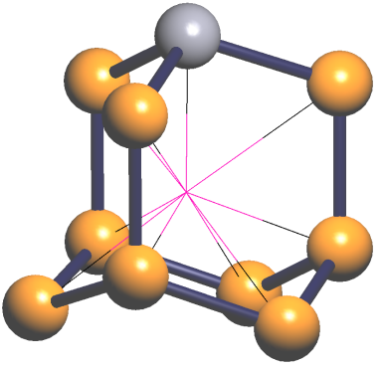
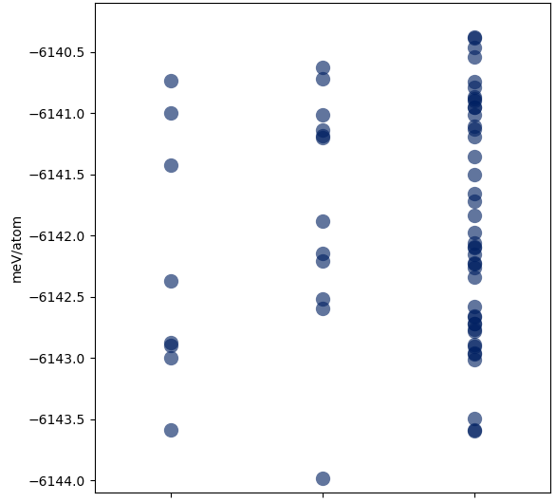
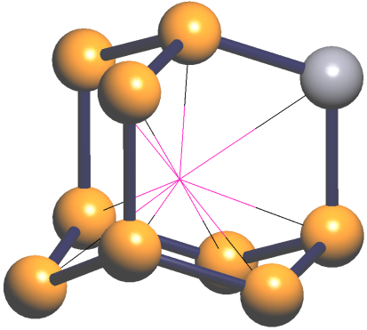
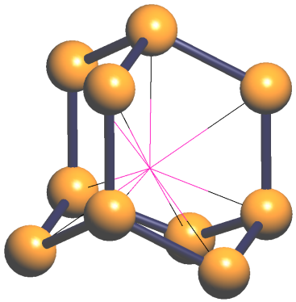
Descriptors of the K ion vacancies formation
Ti atoms positioning in the cage with vacancy
1
2
3
1 2 3

Slide 10
Descriptors of the K ion migration barriers
Ti atoms positioning Fe sublattice (Fe1/Fe2)

Slide 11
Descriptors of the K ion migration barriers
Ti atoms positioning Fe sublattice (Fe1/Fe2)
migration path of the K ion (K1-K1 / K1-K2 / K2-K2)

Slide 12
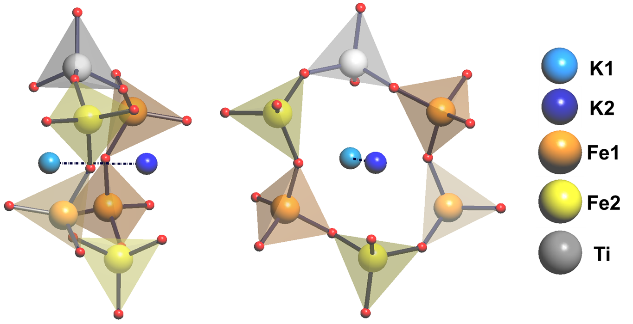
Descriptors of the K ion migration barriers
Ti atoms positioning Fe sublattice (Fe1/Fe2)
migration path of the K ion (K1-K1 / K1-K2 / K2-K2)
Fe and Ti atoms in the “window” which the K ion passes
Fe1|Fe1|Fe1|Fe2|Fe2|Ti

Slide 13
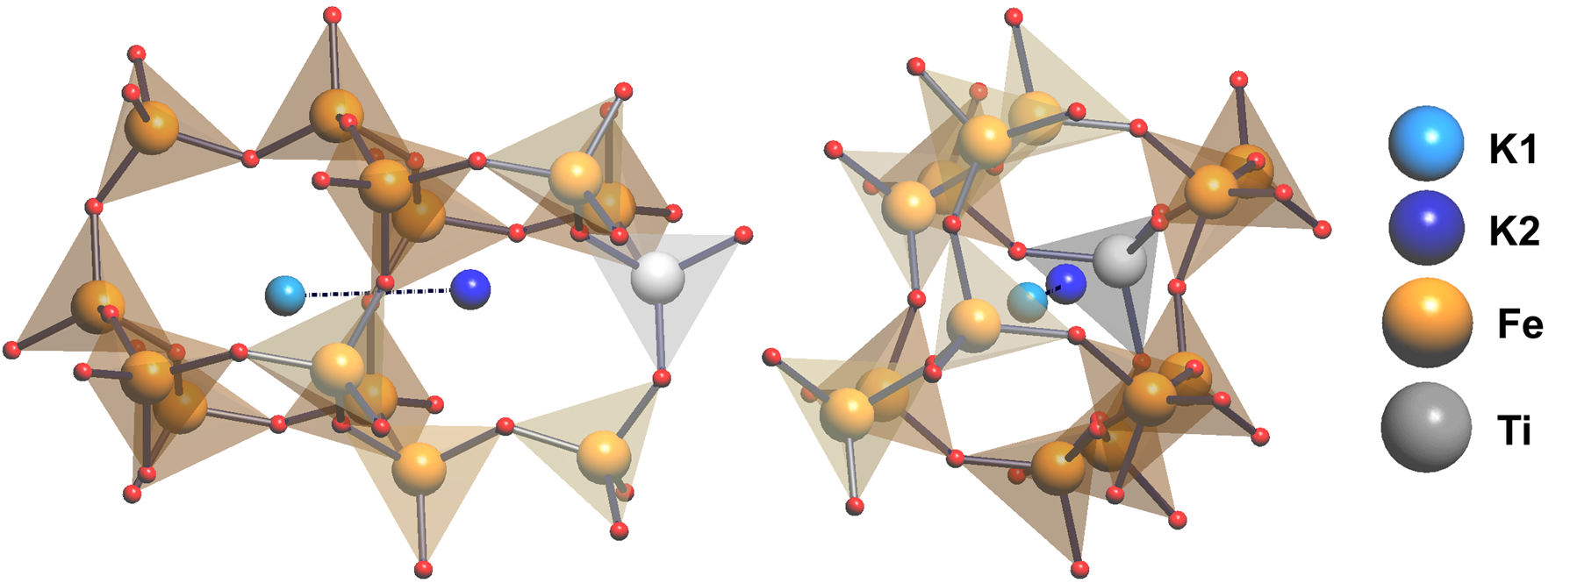
Descriptors of the K ion migration barriers
Ti atoms positioning Fe sublattice (Fe1/Fe2)
migration path of the K ion (K1-K1 / K1-K2 / K2-K2)
Fe and Ti atoms in the “window” which the K ion passes
Ti atoms positioning in the cages involved in the K ion migration
linear (K1-K2-Ti)

Slide 14
Extension and application of the descriptors set to the 2Ti configurational space
K₃₁Fe₃₁TiO₆₄ – 64 non-equivalent configurations with one K vacancy and
128 non-equivalent pathways of the K ion migration
….
Fe to Ti substitution
….
K₃₀Fe₃₀Ti₂O₆₄ – 15552 non-equivalent configurations with one K vacancy and
59520 non-equivalent pathways of the K ion migration
….

Slide 15
Extension and application of the descriptors set to the 2Ti configurational space
1) Extension of the descriptors set: - relative positions of the Ti dopants - relative positions of vacancies
2) Application of the descriptors in the regression model*:
*Zolotarev P., Eremin R. Topology-based description of the NCA cathode configurational space and an approach of its effective reduction //EPJ Web of Conferences 177, 02005 (2018)
Initial set of inequivalent K₃₀Fe₃₀Ti₂O₆₄ configurations
Set of configurations with unique set of the proposed topological descriptors
Energetic characteristics of ion migration process obtained by means of the trained regression model
Calculation of the topological descriptors
DFT modelling of a subset (20-50%) of structures
Ridge regression model training on the calculated energetic characteristics

Slide 16
Thank you for your attention

Slide 17
Acknowledgements
We are obliged to computational facilities of Samara University:
‘Sergey Korolev’ and ‘Zeolite’ (Samara Center for Theoretical Materials Science)
This study was supported by:
the Russian Federation Government (project No.3.6588.2017/9.10)
Russian Foundation for Basic Research (project No.18-33-00477)

Slide 18
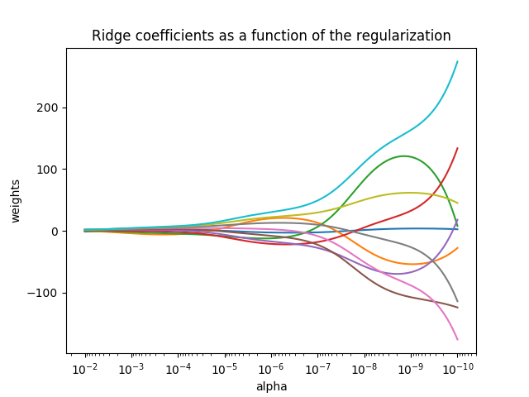
Ridge regression model
Ridge regression addresses some of the problems of ordinary least squares by imposing a penalty on the size of coefficients. The ridge coefficients minimize a penalized residual sum of squares,
$$\min_{w}{{\left\|Xw−y\right\|}_{2}^{2}}+ α{\left\|w\right\|}_{2}^{2}$$
Here, α ≥ 0 is a complexity parameter that controls the amount of shrinkage: the larger the value of α, the greater the amount of shrinkage and thus the coefficients become more robust to collinearity.

