Slide 1
Optimization of selected components in MPD Root project: Capabilities of distributed programming techniques
Fatkina A., Iakushkin O., Gasanova O., Tazieva L.

Slide 2
Outlook
Introduction
MPD, MPD Root
The main purpose
Existing optimizations
Project objectives
Done:
Doxygen generated documentation
Dependency table
Profiling (Valgrind)
Selected technologies
Example
Summary and prospect
Notes:
План доклада

Slide 3
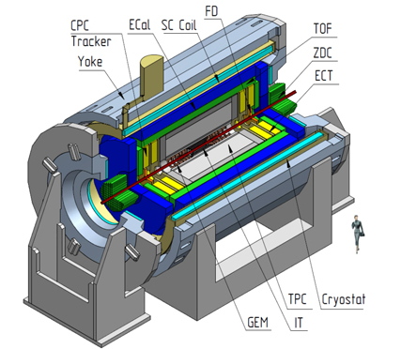
MPD Root Project
MPD (Multi Purpose Detector) – collider experiment aimed at measuring:
Particle yields and spectra;
Event-by-event fluctuations;
Collective flows for identified hadrons species;
Di-lepton decay channels;
Exotics.
MPD Root – Simulation and analysis framework for MPD at NICA.

Slide 4
The main purpose
We are aiming at exploiting all available technologies of contemporary and parallel computing: vectorization, thread-parallelism, multi-computer parallelism.
It is required to cope with extreme input data rates and computational complexity of different algorithms such as track reconstruction, particle reconstruction, etc.

Slide 5
Existing optimizations
Batch processing on the NICA cluster:
252 logical processor cores;
Mpd-scheduler is a tool for simple distribution of MPD Root execution processes.
PROOF:
Parallel Root Facility (PROOF) is a part of Root environment;
Works on multiprocessors/multicore machines, heterogeneous clusters, GRID systems;
Uses data independent parallelism.

Slide 6
Project objectives
Analyze the current structure and workflow of the MPD Root framework;
Select components that can be modified in order to increase the performance of the framework;
Select the most appropriate optimization tools;
Create a list of recommendations for software acceleration;
Implement optimized codes into the framework.

Slide 7
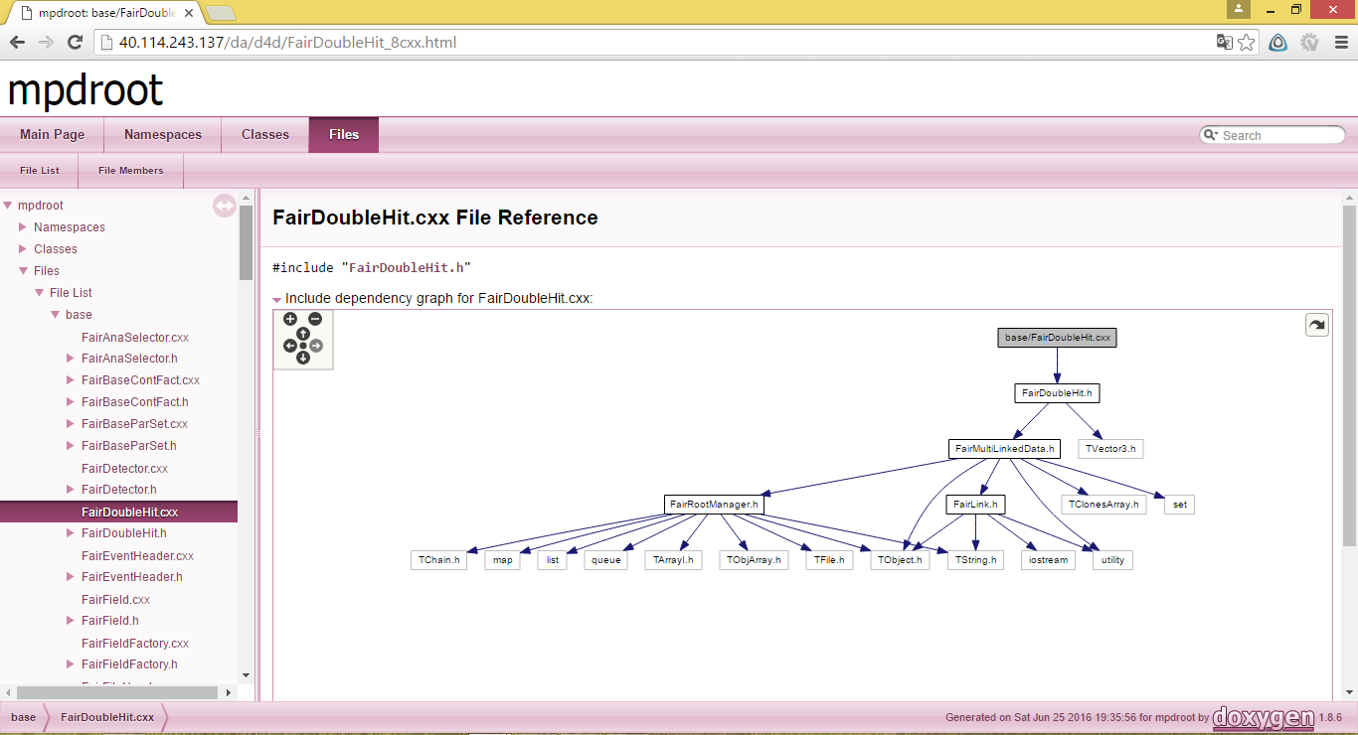
Doxygen generated documentation
In order to perform the comprehensive analysis of the existing code the HTML documentation using Doxygen has been generated.

Slide 8
Dependency table
 | Supported technologies |  |  | Included in dependecies
Library Name | Used for CPU acceleration | Used for GPU acceleration | Used for distributed computing | ROOT | Fair Root | Mpd Root
libfft | OpenMP | cuFFT, OpenCL FFT | MPI
GEANT4 | TBB |  | MPI
Aliroot |  | CUDA
…
Dependency table was drawn up in view of opportunity to optimization

Slide 9
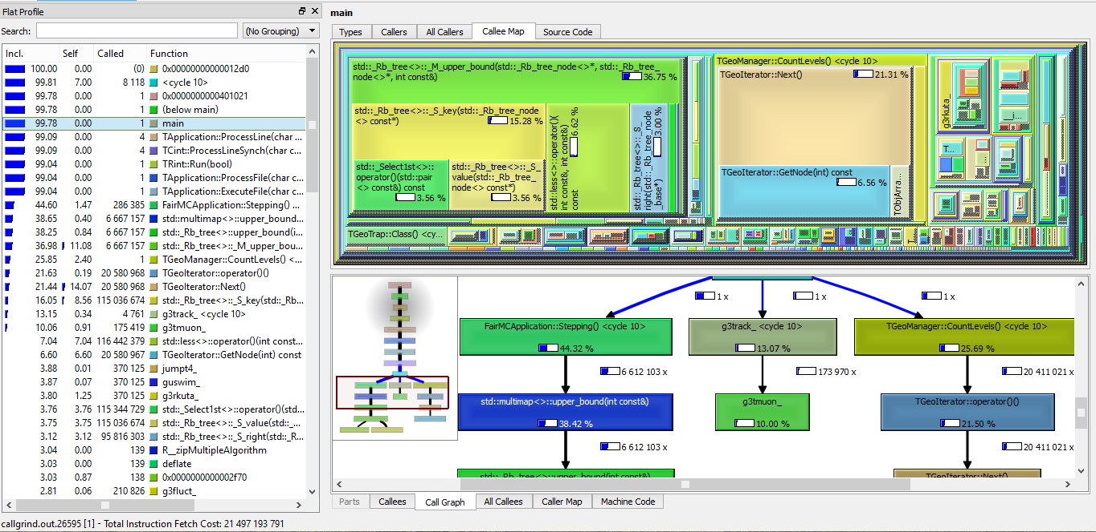
Profiling

Slide 10
Selected technologies
Acceleration type | Technologies
CPU parallelism | OpenMP, Intel TBB
GPU parallelism | CUDA, OpenCL
Distribution | MPI

Slide 11
Potential GPU acceleration example

Slide 12
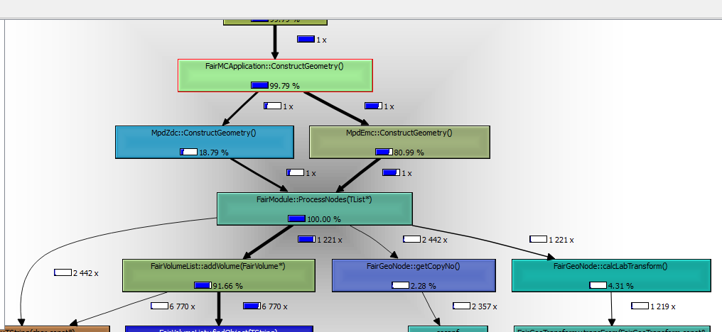
Potential GPU acceleration example
RunMC test for MPDRoot.
ProcessNodes was called twice.
AddValume was called 1221x.

Slide 13
Potential GPU acceleration example
The average work time on CPU about 13x higher than on GPU.
In experiment were used:
GPU: NVIDIA Tesla K40
CPU: Intel Xeon E5-2695v2

Slide 14
Summary and prospect
Summary:
The code has been analyzed;
The technologies has been chosen;
Prospect:
Find all blocks of code, that can be optimized;
Apply possible optimizations and choose the best option;
List recommendations based on results of our research;
Implement optimized code.

Slide 15
Discussion
Thank you for your attention!
This research was partially supported by SPbU (Saint Petersburg State University) grants 9.37.157.2014, 0.37.155.2014 and Russian Foundation for Basic Research grants (project no. 16-07-01113 and no. 16-07-01111).
The authors would like to acknowledge the MPD Root developers and JINR for providing access to the HybriLIT cluster.
Special thanks for access to MPDRoot source code.

